Slide 1


MultiMAE-DER: Multimodal Masked Autoencoder for Dynamic Emotion Recognition
Peihao Xiang, Chaohao Lin, Kaida Wu, Ou Bai
Department of Electrical and Computer Engineering, Florida International University, USA
{pxian001,clin027,kwu020,obai}@fiu.edu
July 9, 2024

Slide 2

Research Background
Emotion Recognition Modalities: Visual (Facial, Behavior), Audio (Speech, Tone), Text (Semantics, Context).
Traditional Emotion Recognition: Single-modality, Static, and Context-free.
Dynamic Emotion Recognition: Multi-modality, Dynamic, and Contextual.
For the emotion recognition in real-time human-computer interaction environments, dynamic emotion recognition is more suitable than traditional emotion recognition, specially, from videos.
Purpose: This study will explore the impact of dynamic feature correlation in multimodal data (i.e., audio-visual cross-domain data) on the emotion recognition (not only facial expressions but also speech emotions).
Notes:
What is the research background? Simply provide the research purpose or impact on emotion recognition, specifically, why do we need to recognition of dynamic emotion recognition? What is the major difference between traditional emotion recognition with dynamic emotion recognition?
Why do we need to do the dynamic emotion recognition over traditional emotion recognition? What exact application(s) needs dynamic emotion recognition which traditional emotion recognition can't provide? Using spatial-temporal features is the approach NOT the purpose for the dynamic emotion recognition! The major difference is the application purposes NOT the approach between traditional emotion recognition and dynamic emotion recognition.
Emotion recognition data: video (facial, behavior), audio (speech, tone), text (semantics, context)
Traditional emotion recognition: single-modal, static, and context-free.
Dynamic emotion recognition: multi-modal, dynamic, and contextual.
Difference: In order to better handle emotion recognition in real-time human-computer interaction environments, dynamic emotion recognition is more suitable for this application than traditional emotion recognition.
Purpose: This study mainly explores the impact of dynamic feature correlation in multimodal data (i.e., audio-visual cross-domain data) on emotion recognition (not only facial expressions but also speech emotions).

Slide 3
Challenges
Considering that the model for extracting dynamically correlated features generally requires a large amount of training data, state-of-the-art dynamic emotion recognition models that are established on the supervised learning from labeled training data may NOT be robust on dynamic emotion recognition.
Further, the current dynamic emotion recognition models only consider the correlation between feature sequences of single modality, either spatially or temporally, while ignoring the advantage of multimodal sequence fusion, i.e., the correlation features between dynamic cross-domain data from the perspective of overall spatiotemporal sequence.
Notes:
2. What are the challenges in dynamic emotion recognition?
A. Due to the limited training data, traditional dynamic data feature model (without self-supervised pretrained large model) may NOT be optimized, which will affect the on extracting dynamically correlated features.
B. Lack of capturing the correlation features between dynamic cross-domain data from the perspective of overall spatiotemporal sequence. The current development of dynamic emotion recognition only considers the correlation between feature sequences of each single modality, while ignoring the feasibility of multimodal sequence fusion.

Slide 4
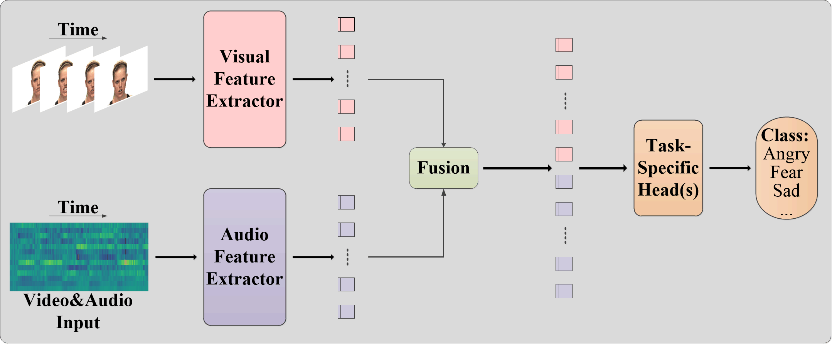
Related Work
State-of-the-Art Modality Fusion:
Single-modal Extract Features
Cross-modal Feature Fusion
Emotion Task-Head
For example, AVT [1] and VQ-MAE-AV [2]
Difference | AVT | VQ-MAE-AV
Feature Extractor | Traditional 3DCNN Model | Self-supervised MAE Pre-trained Model
Fusion Strategy | Self-attention | Cross-attention
RAVDESS Dataset Result | 79.20% | 83.20%
Notes:
3. Summarize the related work on dynamic emotion recognition, how are the state-of-the-art approaches to solve the challenges and what are their performance? – provide most important references
At present, most of the developments in dynamic emotion recognition are to first extract features from each single modality, and then use cross-modal feature fusion strategies (e.g., attention mechanisms) to associate the identically distributed features of multimodal to improve the accuracy of dynamic emotion recognition. For example, AVT [1] and VQ-MAE-AV [2].
Compared with AVT, VQ-MAE-AV performs better on challenges A and B. It uses the pretrained feature extractor by masked autoencoder (MAE) to eliminate the bias caused by insufficient training data. At the same time, it uses the cross-attention fusion strategy to replace the self-attention fusion strategy in AVT. It improves the accuracy by 4% on the RAVDESS dataset (83.20% vs. 79.20%).
[1] Chumachenko, Kateryna, Alexandros Iosifidis, and Moncef Gabbouj. "Self-attention fusion for audiovisual emotion recognition with incomplete data." 2022 26th International Conference on Pattern Recognition (ICPR). IEEE, 2022.
[2] Sadok, Samir, Simon Leglaive, and Renaud S´eguier. "A vector quantized masked autoencoder for audiovisual speech emotion recognition." 2023 IEEE International conference on acoustics, speech, and signal processing workshops (ICASSPW). IEEE, 2023.

Slide 5
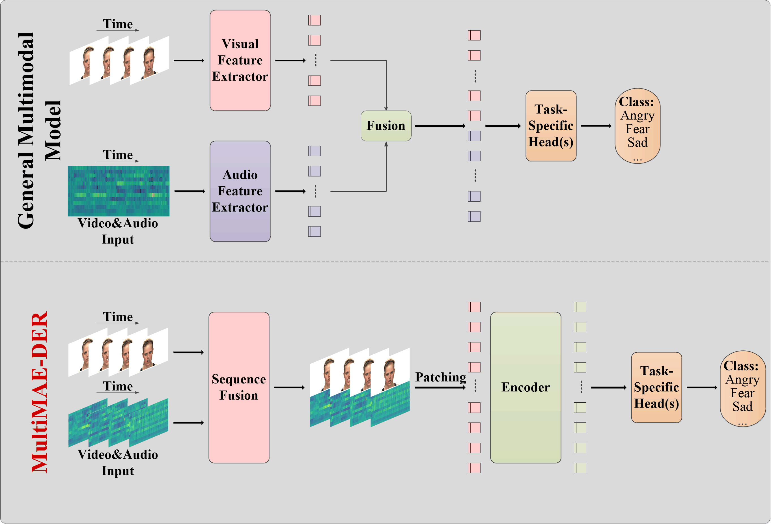
Motivation
Explore efficient methods to extract dynamic feature correlations across cross-domain data from:
Spatial-only sequence
Temporal-only sequence
Spatiotemporal sequence

Slide 6
Contribution
A New Framework for dynamic emotion recognition that extending the conventional approach using single-modal input to multimodal input encompassing both visual and audio elements.
Optimizing Visual-Audio sequence fusion strategies.

Slide 7
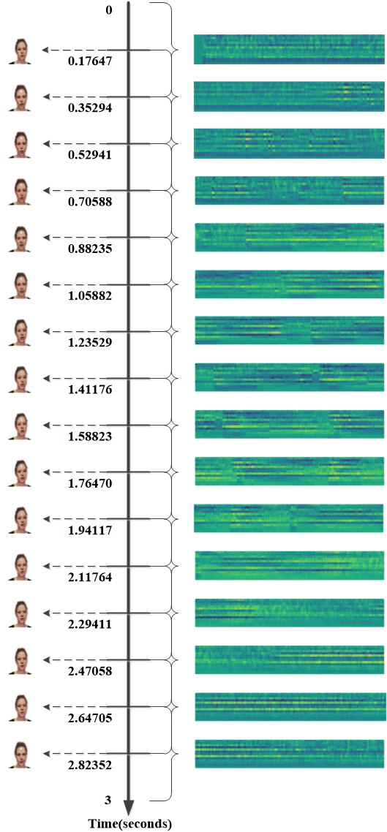
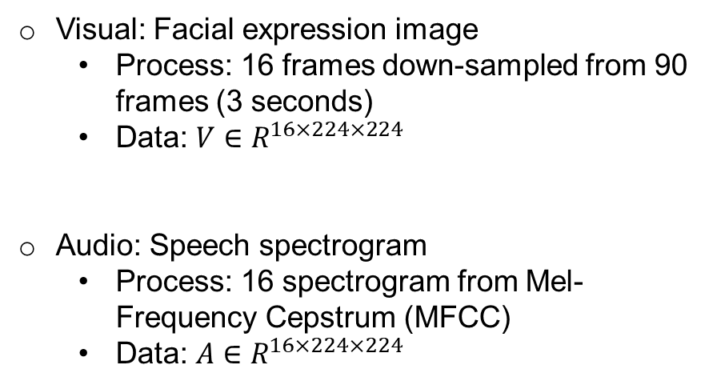
Map of Visual vs. Audio
Visual: Facial expression image
Process: 16 frames down-sampled from 90 frames (3 seconds)
Data: $V∈R^{16×224×224}$
Audio: Speech spectrogram
Process: 16 spectrogram from Mel-Frequency Cepstrum (MFCC)
Data: $A∈R^{16×224×224}$

Slide 8
Multimodal Sequence Strategy
……….
Strategy 1: Combine of Facial and Spectrogram (CFAS)
Where $i$ is the time index, $i∈[1,16]$.
Strategy: Concatenation
Reason: Planar spatial integrity on dynamic emotion recognition.

Slide 9
Multimodal Sequence Strategy
……….
Strategy 2: Sum of Facial and Spectrogram (SFAS)
Where $i$ is the time index, $i∈[1,16]$.
Strategy: Superposition
Reason: Depth spatial integrity on dynamic emotion recognition.

Slide 10
Multimodal Sequence Strategy
……
……
Strategy 3: First Facial Later Spectrogram (FFLS)
Where $V_{i}$ and $A_{i}$ are the video and audio time sequences, $i∈[1,8]$.
Strategy: Visual-auditory continuous sequence
Reason: Visual-auditory spatiotemporal integrity on dynamic emotion recognition.

Slide 11
Multimodal Sequence Strategy
……
……
Strategy 4: First Spectrogram Later Facial (FSLF)
Where $V_{i}$ and $A_{i}$ are the video and audio time sequences, $i∈[1,8]$.
Strategy: Audio-visual continuous sequence
Reason: Audio-visual spatiotemporal integrity on dynamic emotion recognition.

Slide 12
Multimodal Sequence Strategy
……….
Strategy 5: One Facial One Spectrogram (OFOS)
Where $V_{i}$ and $A_{i}$ are the video and audio time sequences, $i∈[1,8]$.
Strategy: Discrete sequence
Reason: Audio-visual periodic temporal sequences on dynamic emotion recognition.

Slide 13
Multimodal Sequence Strategy
……….
Strategy 6: Random of Facial and Spectrogram (RFAS)
Where $V_{i}$ and $A_{i}$ are the video and audio time sequences, $i∈[1,8]$.
Strategy: Random sequence
Reason: Audio-visual random spatiotemporal sequences on dynamic emotion recognition.

Slide 14
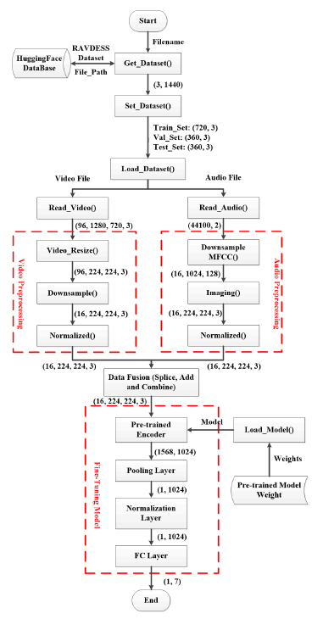
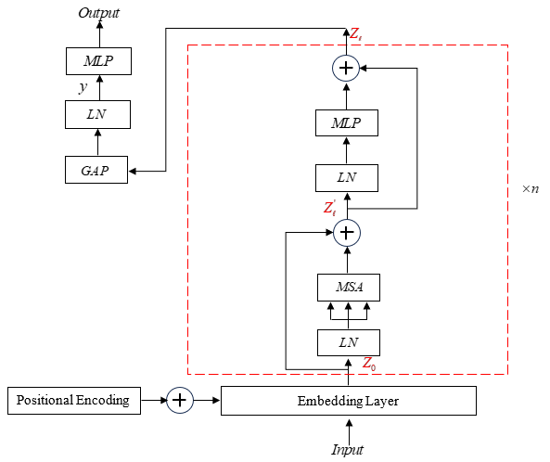
MultiMAE-DER: Model Structure
Notes:
What is the basic idea of MultiMAE-DER; why we employ this for the spatio-temporal attention.
Basic idea:
1. Direct sequence fusion of audio-visual signals.
2. Use VideoMAE (Backbone Network: ViT) to extract dynamic features of the overall fusion sequence.
3. The dynamic features will contain the representation information of the audio-visual sequence in terms of spatiotemporal association.
Spatio-temporal attention:
In order to capture the spatiotemporal correlation dynamic features in audio-visual sequences, attention is paid to both the flow video and the corresponding frame images.

Slide 15
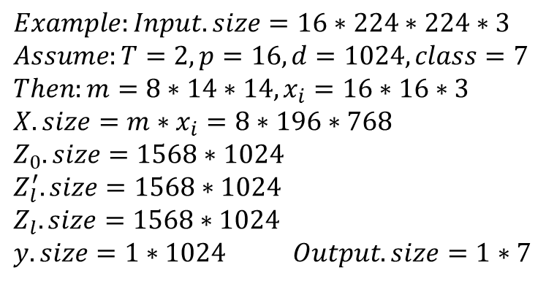
Process Details
Input:
Where, the length for any $x_{i}$ is $p^{2}∙C$
Encoder Processing Steps:
$$Example:Input.size=16∗224∗224∗3$$
$$Assume:T=2,p=16, d=1024,class=7$$
$$Then:m=8∗14∗14, x_{i}=16∗16∗3$$
$$X.size=m∗x_{i}=8∗196∗768$$
$$Z_{0}.size=1568∗1024$$
$$Z_{l}^{′}.size=1568∗1024$$
$$Z_{l}.size=1568∗1024$$
$$y.size=1∗1024 Output.size=1∗7$$

Slide 16
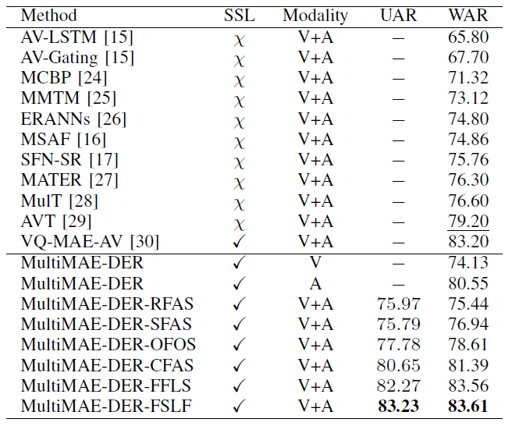
RAVDESS Dataset Evaluation
Major Findings:
Best Strategy: MultiMAE-DER-FSLF (strategy 4)
Outperforms the supervised model AVT by 4.41% (83.61% vs. 79.20%).
Outperforms the self-supervised model VQ-MAE-AV by 0.41% (83.61% vs. 83.20%).
Outperforms the visual-only model by 9.48% (83.61% vs. 74.13%).
Outperforms the audio-only model by 3.06% (83.61% vs. 80.55%).
Notes:
What is the major finding from this results? 1. Show better performance than the state-of-the-art? 2. Suggesting a better fusion strategy?
Please use bulletins to write the above information
SSL: Self-supervised learning method or not. UAR: Unweighted average recall. WAR: Weighted average recall. UNDERLINED: The best supervised result. BOLD: The best result.
Compared MultiMAE-DER with other previous state-of-the-art multimodal models on the RAVDESS [19]. As shown in Table 1, in the multimodal model domain, the results exhibit significant variations based on different learning methods, whether supervised learning or self-supervised learning. The self-supervised multimodal model VQ-MAE-AV [30] outperforms the supervised multimodal model AVT [29] by 4% (83.20% vs. 79.20%) in terms of WAR. Furthermore, our MultiMAE-DER model, employing different multimodal sequence fusion strategies, generally surpasses the supervised multimodal model. Particularly, when using strategy 4, MultiMAE-DER-FSLF outperforms the supervised model by 4.41% (83.61% vs. 79.20%) in terms of WAR. Among the self-supervised multimodal models, our optimal strategy (i.e., strategy 4 FSLF) of MultiMAE-DER also outperforms the multimodal model VQ-MAE-AV [30] by 0.41% (83.61% vs. 83.20%) in terms of WAR. On the other way, compared with the MultiMAE-DER single-modal model, the MultiMAE-DER multi-modal optimal strategy model (FSLF) is far superior in performance to the visual-only model and the audio-only model. The results show that the WAR on RAVDESS [19] is enhanced by 9.48% (83.61% vs. 74.13%) and 3.06% (83.61% vs. 80.55%) respectively.

Slide 17
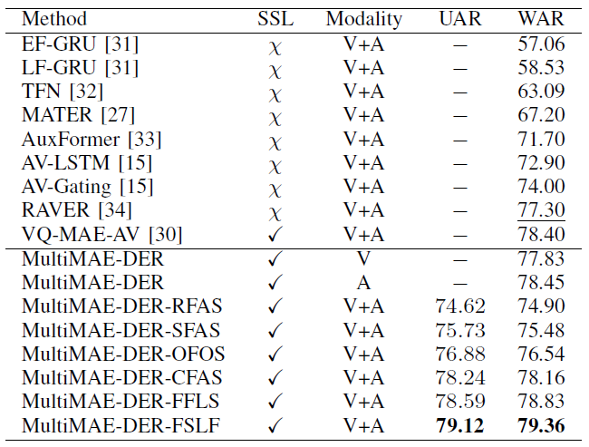
CREMA-D Dataset Evaluation
Major Findings:
Best Strategy: MultiMAE-DER-FSLF (strategy 4)
Outperforms the supervised model RAVER by 2.06% (79.36% vs. 77.30%).
Outperforms the self-supervised model VQ-MAE-AV by 0.96% (79.36% vs. 78.40%).
Outperforms the visual-only model by 1.53% (79.36% vs. 77.83%).
Outperforms the audio-only model by 0.91% (79.36% vs. 78.45%).
Notes:
SSL: Self-supervised learning method or not. UAR: Unweighted average recall. WAR: Weighted average recall. UNDERLINED: The best supervised result. BOLD: The best result.
The visual-audio results on the CREMA-D [20] are presented in Table 2. We observe that the optimal strategy of MultiMAE-DER achieves the WAR result surpassing the VQ-MAE-AV [30] multimodal self-supervised learning model by 0.96% (79.36% vs. 78.40%). Compared to supervised learning approaches, the optimal strategy of MultiMAE-DER outperforms the multimodal model RAVER [34] by 2.06% (79.36% vs. 77.30%) in WAR. In addition, most of the results of other strategies in MultiMAE-DER outperform state-of-the-art multimodal supervised learning models. This indicates the effectiveness of multimodal sequence fusion strategies, which can aid in identifying spatio-temporal correlations across cross-domain data to some extent. On the other way, compared with the MultiMAE-DER single-modal model, the MultiMAE-DER multi-modal optimal strategy model (FSLF) is far superior in performance to the visual-only model and the audio-only model. The results show that the WAR on CREMA-D [20] is enhanced by 1.53% (79.36% vs. 77.83%) and 0.91% (79.36% vs. 78.45%) respectively.

Slide 18
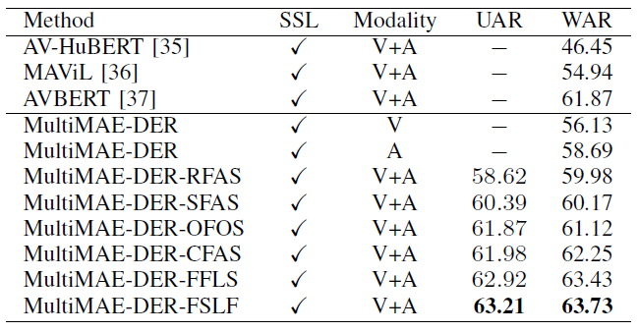
IEMOCAP Dataset Evaluation
Major Findings:
Best Strategy: MultiMAE-DER-FSLF (strategy 4)
Outperforms the self-supervised model AVBERT by 1.86% (63.73% vs. 61.87%).
Outperforms the visual-only model by 7.60% (63.73% vs. 56.13%).
Outperforms the audio-only model by 5.04% (63.73% vs. 58.69%).
Notes:
SSL: Self-supervised learning method or not. UAR: Unweighted average recall. WAR: Weighted average recall. BOLD: The best result.
In Table 3, we compare state-of-the-art self-supervised multimodal models on the IEMOCAP [21]. The results are derived from the evaluation test conducted by AV-Superb [22]. The results showed that in the field of self-supervised learning, our MultiMAE-DER optimal strategy model (FSLF) outperforms the multimodal model AVBERT [37] by 1.86% (63.73% vs. 61.87%) in WAR. Upon observing the results of
multiple strategies in our model and comparing them with the results of these three self-supervised multimodal models, we notice that MultiMAE-DER model performs slightly better in handling cross-domain data. This indirectly reflects the model’s ability to extract representational information regarding spatio-temporal correlations across cross-domain data. Moreover, these dynamic features play a crucial role in inferring emotional context. On the other way, compared with the MultiMAE-DER single-modal model, the MultiMAE-DER multi-modal optimal strategy model (FSLF) is far superior in performance to the visual-only model and the audio-only model. The results show that the WAR on IEMOCAP [21] is enhanced by 7.60% (63.73% vs. 56.13%) and 5.04% (63.73% vs. 58.69%) respectively.

Slide 19
Analysis
Results indicate that fusing multimodal data on spatio-temporal sequences significantly improves the model performance by capturing correlations between cross-domain data.
Strategy 1 (CFAS) exhibits temporal continuity but lacks spatial continuity.
Strategy 2 (SFAS) has temporal continuity but disrupts the overall spatial sequence structure.
Strategies 3 (FFLS) and 4 (FSLF) demonstrate both spatial and temporal continuity, with a high concentration of spatio-temporal correlation.
Strategy 5 (OFOS) shows spatial continuity but disrupts the overall temporal sequence structure.
Strategy 6 (RFAS) lacks both spatial and temporal continuity, simultaneously disrupting the overall spatio-temporal correlation.

Slide 20
Conclusion
An exploration to handle multimodal data for dynamic emotion recognition - introducing a novel framework for the multimodal data integration established on self-supervised learning models.
Investigation on six different multimodal sequence fusion strategies to explore diverse interpretations of multimodal correlation information extracted from a pre-trained model.

Slide 21
Thanks for listening!
https://hcps.fiu.edu/
Human Cyber-Physical Systems Laboratory

